Slide 1
Inference of protein secondary structure motifs
Predicting α-helix secondary structure
Group 10 · Alsu Alimzanova, Nazrin Azizova, Munish Patwa, Rohit Stanly

Slide 2
What are we trying to predict?
A protein consists of a sequence of amino acids from the 20 standard types (A, L, G, E, K, …).
Each amino acid represents either an alpha-helix or other structures. The goal is to calculate the probability of a helix, P(helix), for each position of the amino acids. This process does not involve predicting the amino acid letters; instead, the letters serve as the input.
Input: amino-acid sequence
A L G E K M V
Output: probability of helix at each position
0.05 0.14 0.72 0.83 0.20 ...
Given the protein letters, we estimate which parts are likely to be" α-helices.

Slide 3
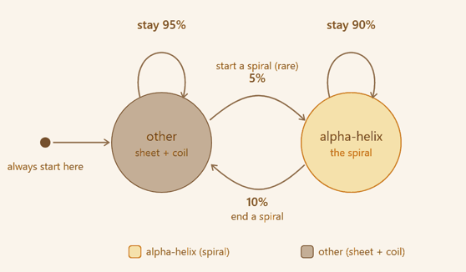
The two-state HMM: how hidden structure changes
Setup:
Two hidden states: alpha-helix and other.
Every simulated chain starts in other.
Helices appear as continuous segments, not isolated random points.

Slide 4
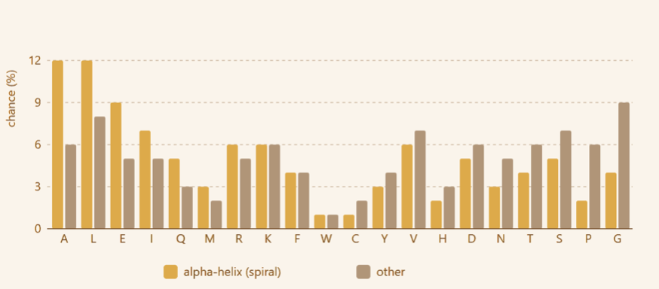
How hidden states produce amino acids?
Yellow bars: P(amino acid | alpha-helix). Grey bars: P(amino acid | other).
A and L are more common in helix while G and P are more common in other.
A can still appear in other, and G can still appear in helix.
Forward–Backward uses these probabilities together with the transition rules.

Slide 5
Where Simulation-Based Inference appears?
1. Simulator makes fake protein chains with known hidden states.
2. Forward–Backward computes exact HMM posterior probabilities: P(helix | sequence).
3. BayesFlow studies many pairs: sequence window → posterior probability.
4. After training, test performed on human insulin
5. Evaluation compares BayesFlow, Forward–Backward, and known ground truth.
what is an idea behind SBI?
when real labeled data are limited or inference is costly, use a simulator to generate training examples

Slide 6
Forward-Backward
How it works?
we provide input: one amino-acid sequence from the simulator.
and expect output: one probability per position: P(helix at position i | whole sequence).
These probabilities are called gamma/posteriors in the HMM.
They are exact for the fixed HMM, BayesFlow is trained to reproduce them.
Important: exact for the HMM does not mean perfect biological truth.
Example
Sequence: A L G E K
FB output: 0.03 0.28 0.65 0.82 0.20
Forward-Backward is a teacher
BayesFlow is a student
On simulated data, FB reached AUC ≈ 0.798 vs true hidden states — this is the HMM ceiling because emissions overlap.
On simulated data, exact FB achieves AUC ~ 0.798 vs true hidden states. This is the HMM ceiling because helix/other emission tables overlap

Slide 7

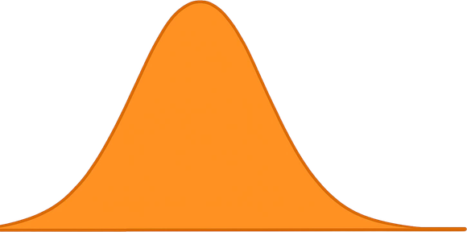


BayesFlow learns from local sliding windows
P(helix) for center residue
A K L A E E L A L G S T
sliding window: 31 residues (±15)
center on the residue
posterior mean ± uncertainty
CouplingFlow outputs a posterior distribution, summarized by mean ± uncertainty.
Sliding the window along the chain gives one prediction per residue.
one-hot encoding
CouplingFlow
31 positions x 21 channels
(20 amino acids + 1 padding)
amortized posterior

Slide 8
How we fitted BayesFlow
Training target | Forward-Backward P(helix), as logit
Input | 31 x 21 one-hot sliding window
Network | BayesFlow CouplingFlow
Training data | around 300,000 windows from 15,000 chains
Regime | offline, Adam, 30 epochs, batch 512
Validation | held-out tail block - no leakage (asserted)
BayesFlow is not trained directly on real labels. It is trained to imitate the
exact HMM posterior produced by Forward-Backward

Slide 9
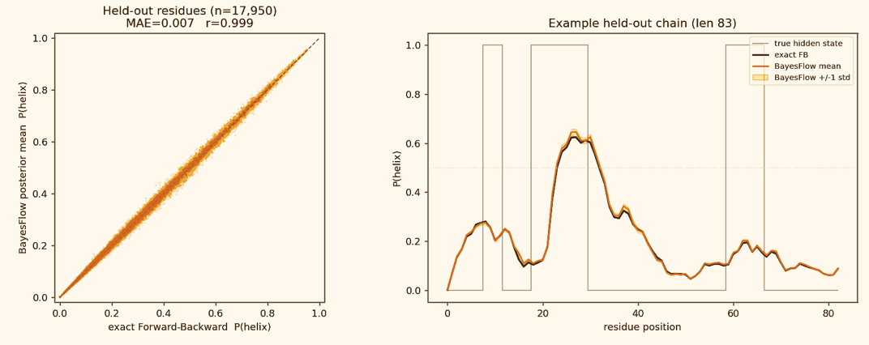
Held-out simulated validation
BayesFlow near-perfectly reproduced exact Forward-Backward on unseen simulation.
Results:
correlation r = 0.999 and MAE = 0.007
BayesFlow is interchangeable with FB for this HMM.

Slide 10
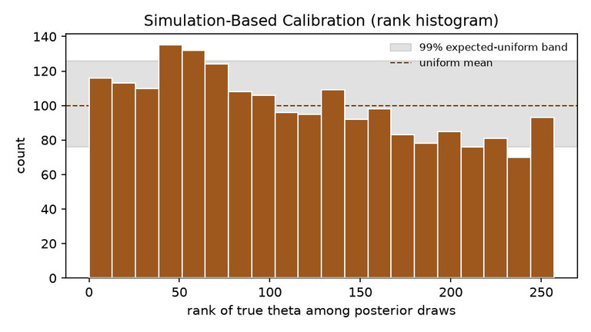
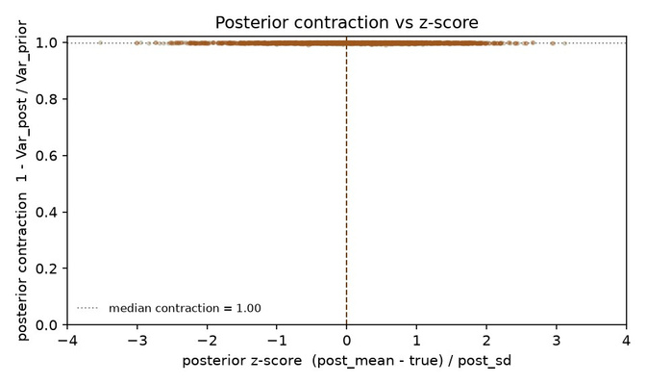
Is the posterior trustworthy?
2 checks: calibration (SBC) and posterior contraction
SBC rank histogram - calibration
Posterior contraction vs z-score
Posterior contraction ~ 1.0 - the window removes almost all prior uncertainty
Calibration is close, but SBC is not flat - a small location bias, not an over-narrow posterior
This is not a bug: it is a tunable accuracy-calibration trade-off (next slide)

Slide 11
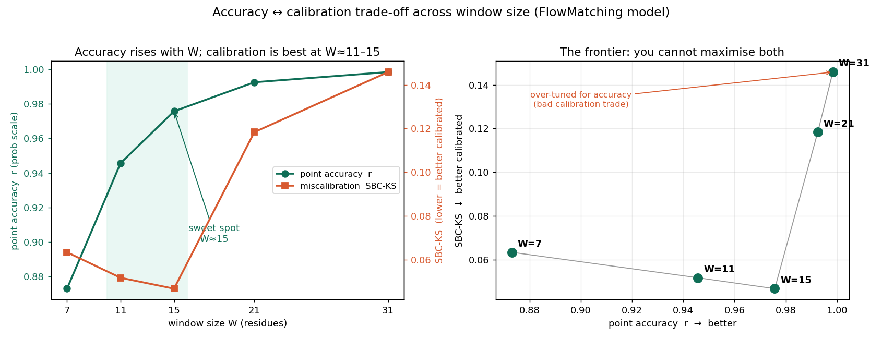
The accuracy-calibration trade-off
We swept the window size W in {7,11,15,21,31} and measured point accuracy (r) and calibration (SBC-KS)
Accuracy rises with W (r 0.87 -> 0.998); calibration is U-shaped, best at W=11-15 then degrades 2-3x
W=15 is the knee: near-top accuracy (r 0.976) AND best calibration - a knob to tune, not a defect

Slide 12
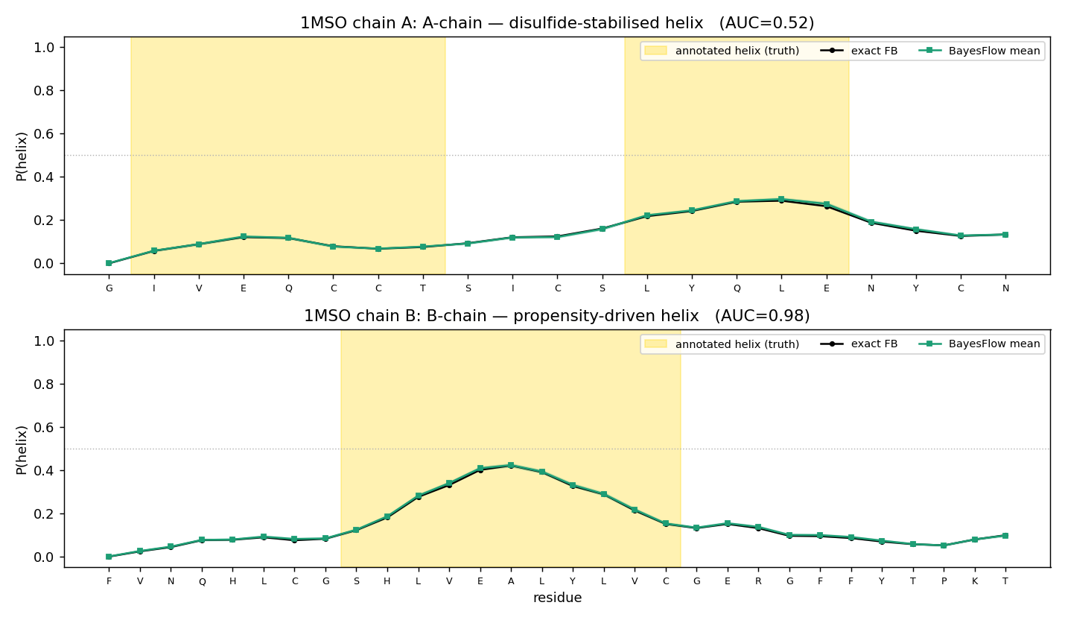
First real protein: human insulin
trained only on simulation
Wild-type insulin (1MSO): P(helix) rises inside the annotated B-chain helix
B-chain AUC 0.98, but A-chain 0.52 (chance) - BayesFlow and exact FB agree
A-chain helix is likely disulfide-stabilised (consistent with the data); a sequence-only HMM cannot see 3-D bonds
P(helix): BayesFlow vs exact FB; gold band = annotated helix (truth)

Slide 13
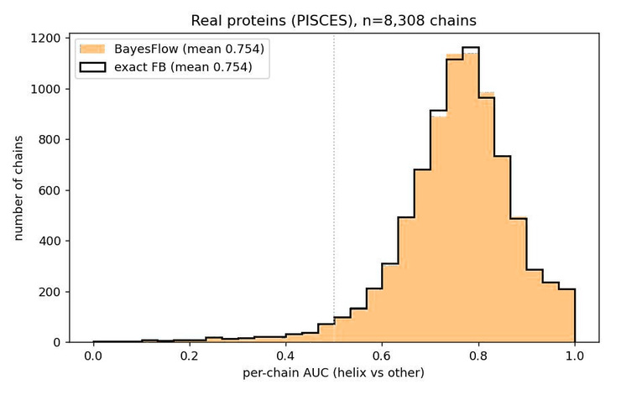
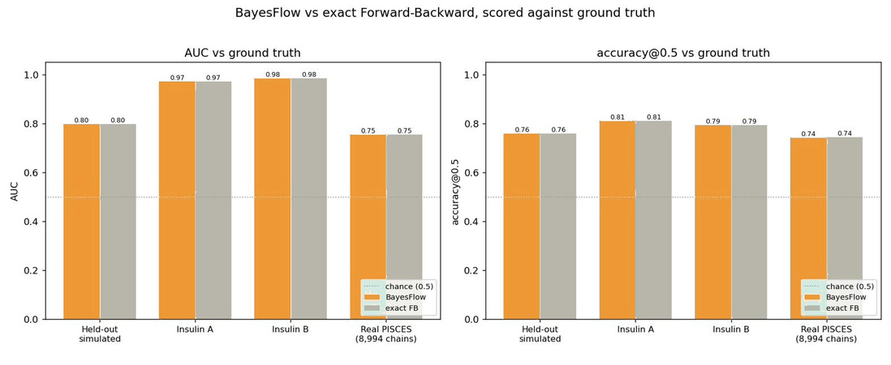
Does it hold across the real proteome?
All 8,994 real PISCES chains - BayesFlow vs exact Forward-Backward.
Per-chain AUC over real chains - BayesFlow = exact FB
AUC & accuracy across all four settings - BayesFlow vs FB
Scored all 8,994 real chains; per-chain AUC 0.75 over the 8,308 with both classes
BayesFlow = exact FB everywhere ( held-out, insulin, PISCES)
Held-out sim: correlation 0.999 with FB - interchangeable

Slide 14
Summary
BayesFlow reproduces the exact HMM posterior.
BayesFlow learns the HMM world only, not the real biology.
Real-data AUC around 0.75 shows useful signal
What BayesFlow
Can do
Cannot do
Fast amortized approximation of Forward-Backward posteriors
Recover biological structure that is absent from the simulator
munish.patwa@tu-dortmund.de · rohit.stanly@tu-dortmund.de
nazrin.azizova@tu-dortmund.de · alsu.alimzanova@tu-dortmund.de

